Slide 1
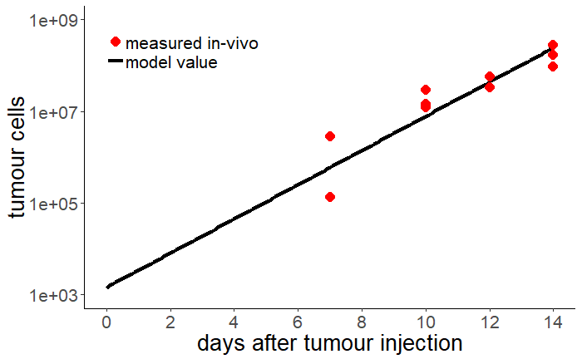
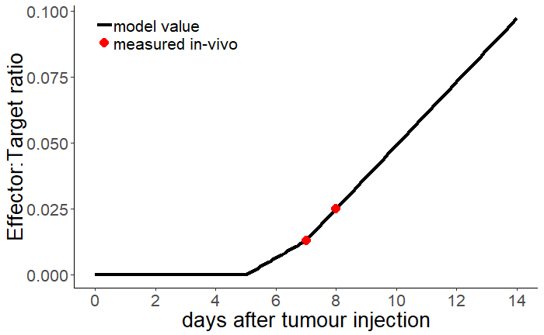
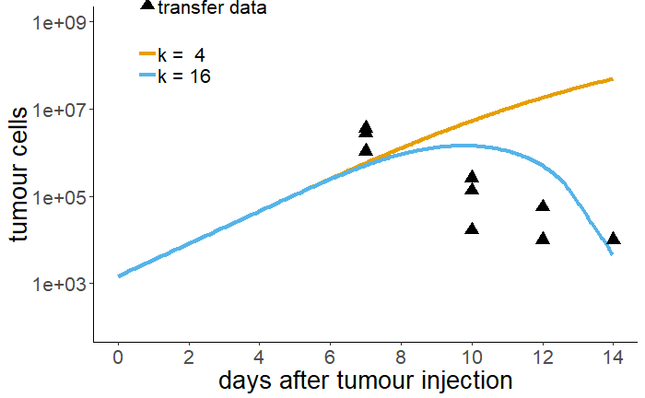
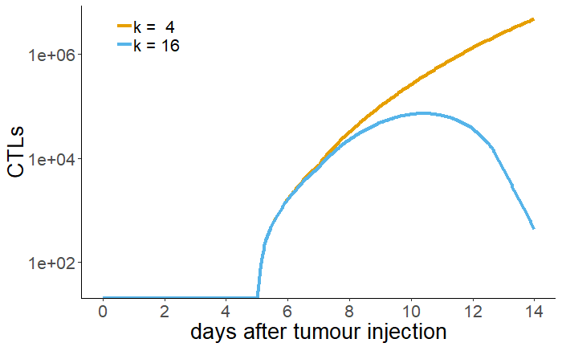
A
B
C
D

Slide 2
Figure 1. ODE model suggests direct T cell cytotoxicity is insufficient for control of EG7 tumours. A) Tumour growth is described as exponential growth (g=0.86 day⁻¹). B) T cell density in the ODE model is estimated by linear interpolation of measured data points. After day 8, we assume a linear increase in CTL density. C) ODE simulation of tumour dynamics in the presence of actively killing CTLs, with two different killing rates. Solid lines represent model fits and dots represent experimental data. D) Total number of CTL in killing simulation.

Slide 3
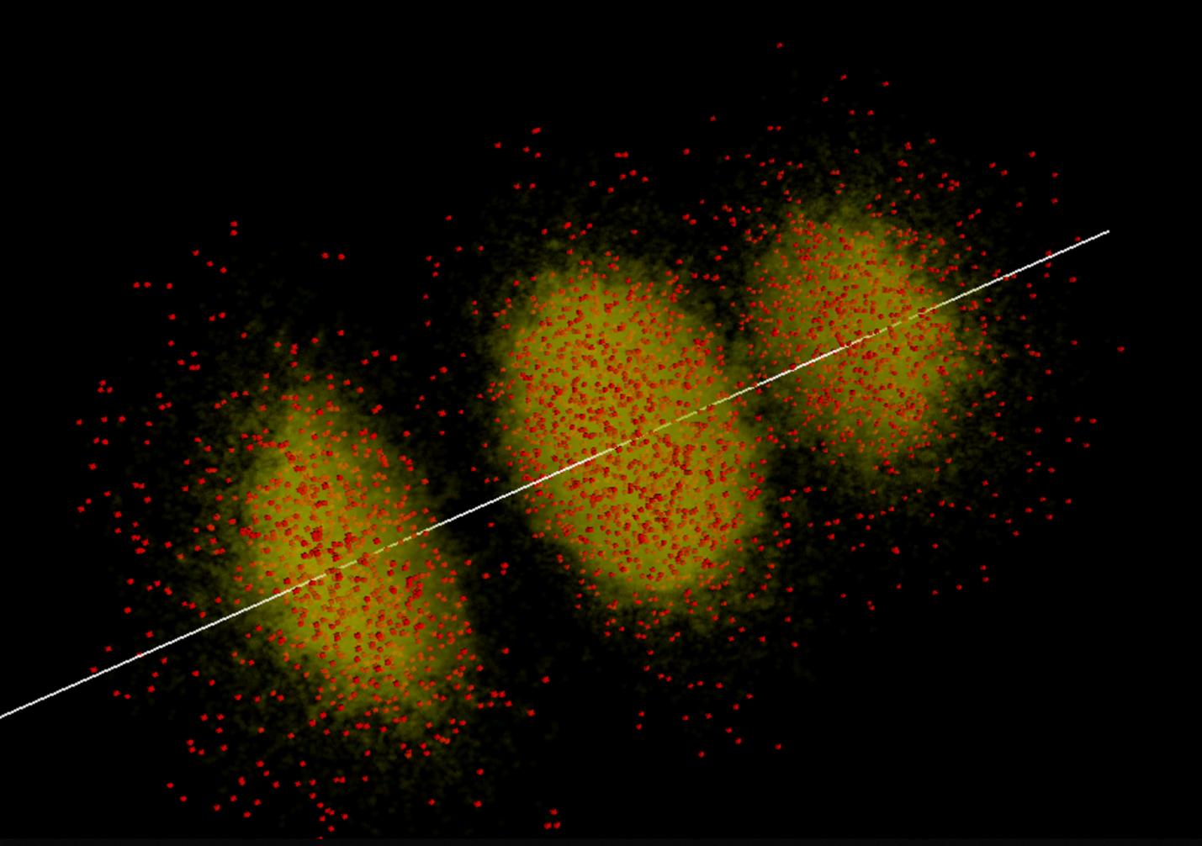
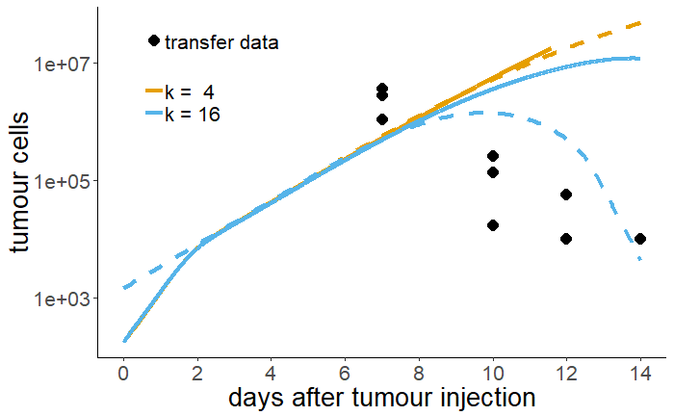
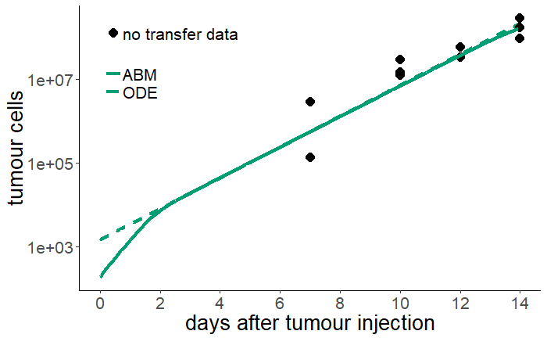
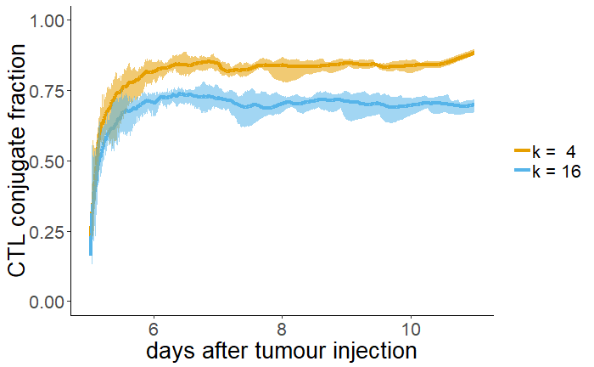
A
B
C
D

Slide 4
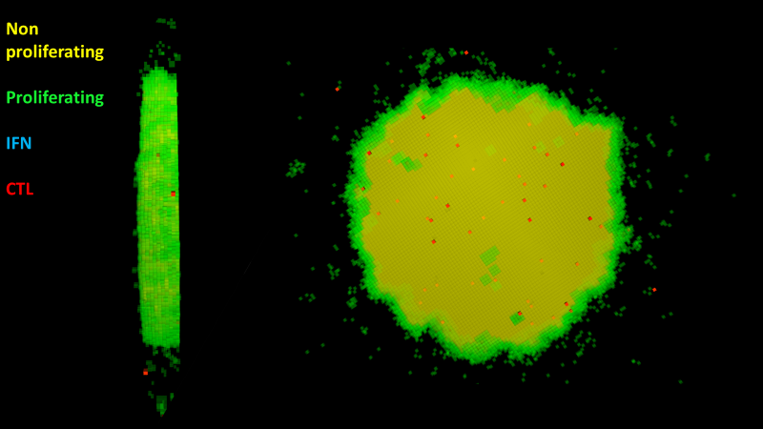

Slide 5
Figure 2. ABM confirms that direct T cell cytotoxicity is insufficient for control of EG7 tumours. A) ABM tumour (yellow) infiltrated by CTLs (red) on day 8. B) ABM growth without and C) with transferred population of CTLs. D) Fraction of CTLs in a conjugate with a tumour cell throughout ABM simulations.

Slide 6
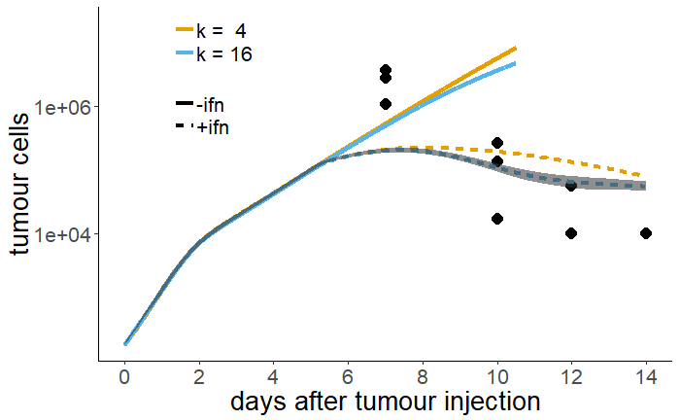
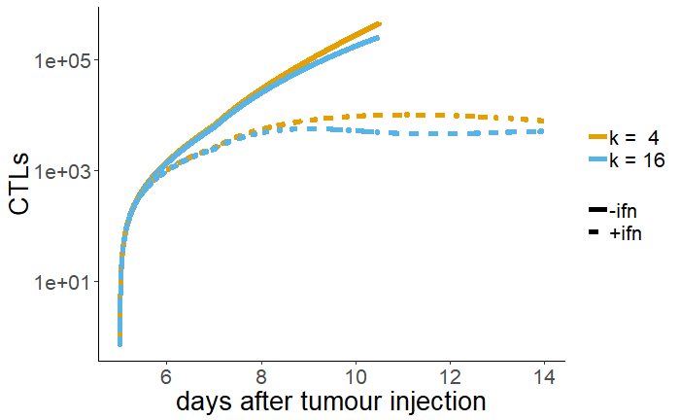
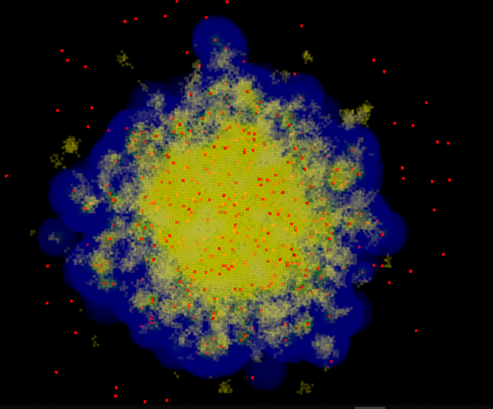
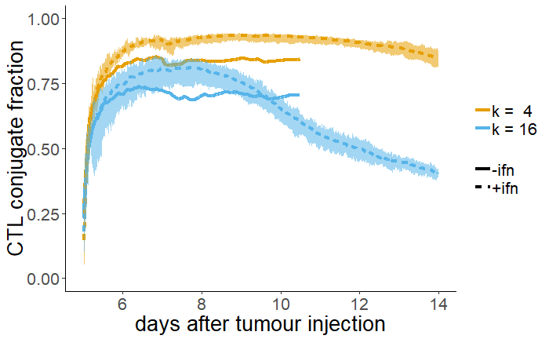
A
B
C
D

Slide 7
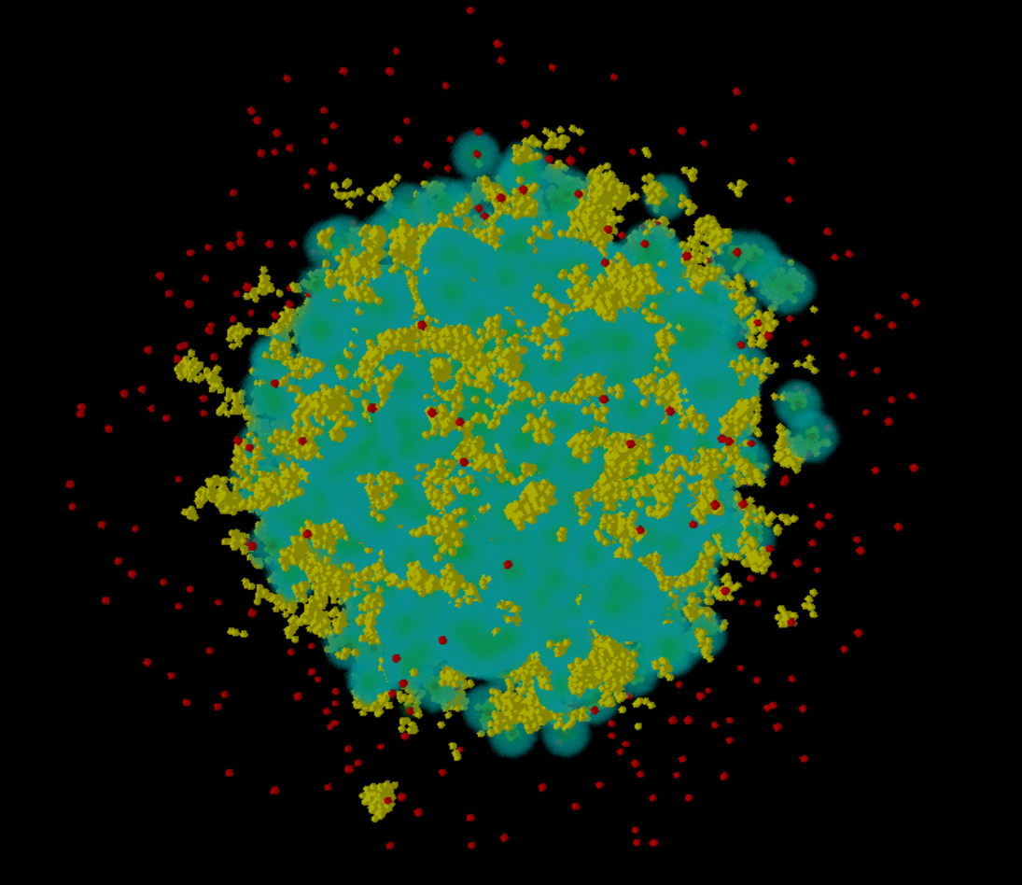
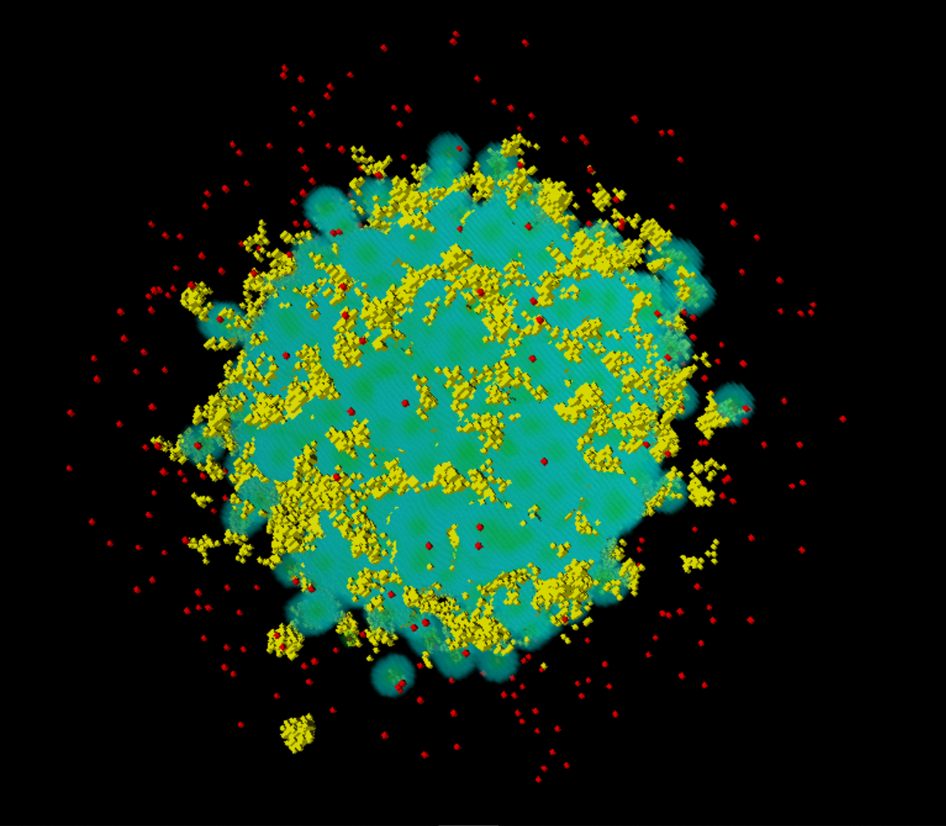

Slide 8
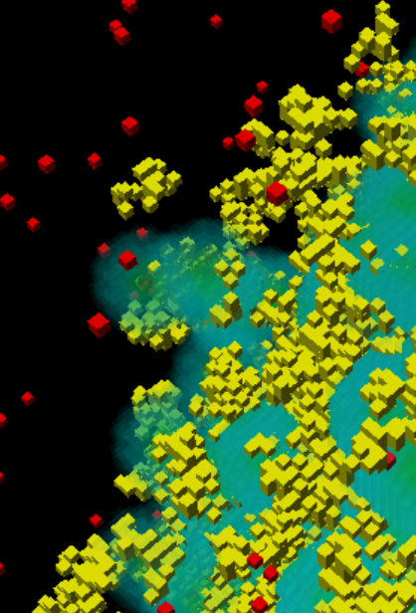
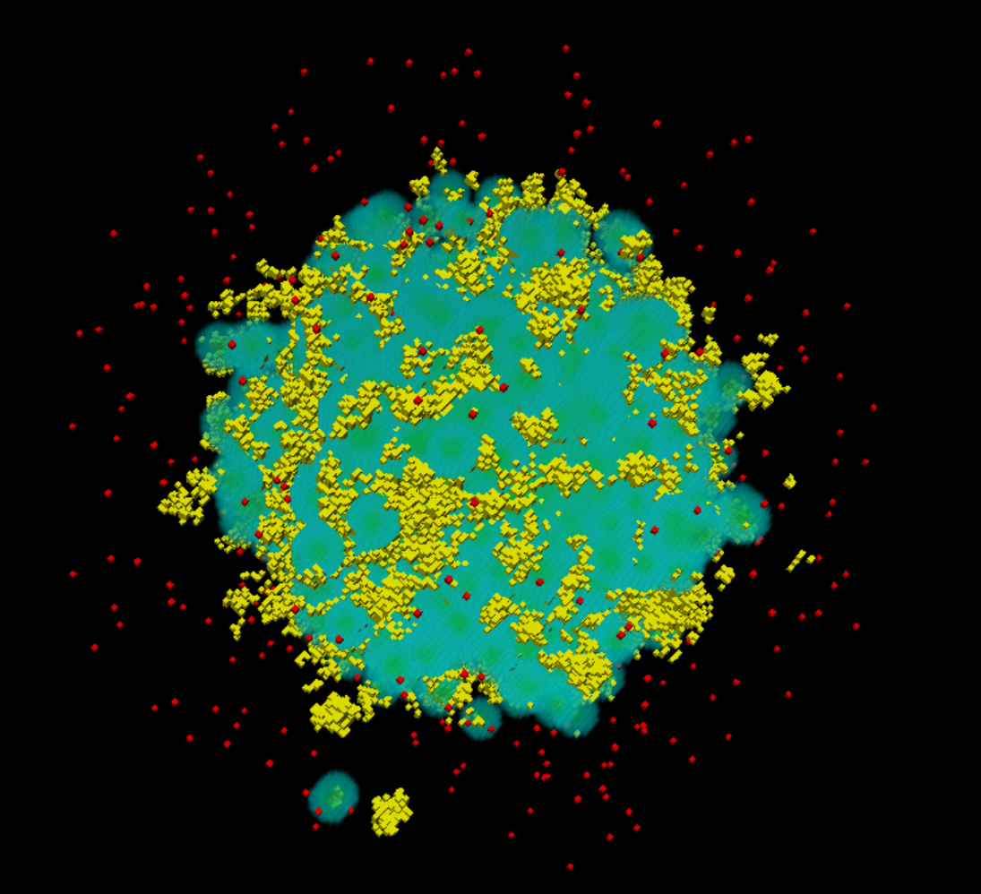

Slide 9
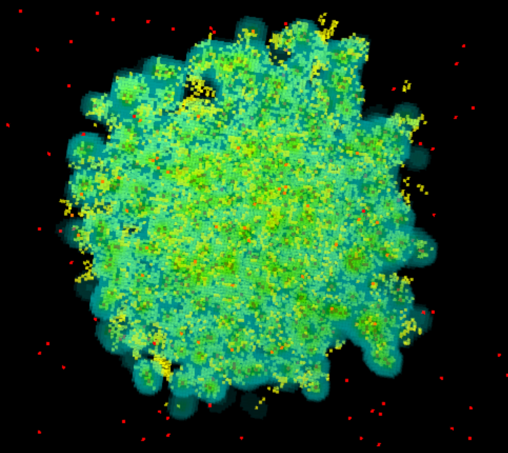

Slide 10
Figure 3. Antiproliferative IFNγ can explain low measured killing rate. A) Simulated tumour volume compared with and without IFNγ producing CTL B) Total CTL numbers in simulations with or without IFNγ C) Fraction of CTL in conjugates in simulations with and without IFNγ D) Quasi-3d slice from tumour on day 8, in the presence of IFNγ (Red=CTL; yellow=tumour; blue = IFN).

Slide 11
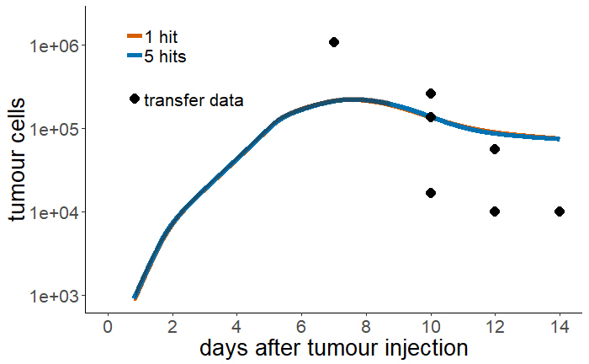
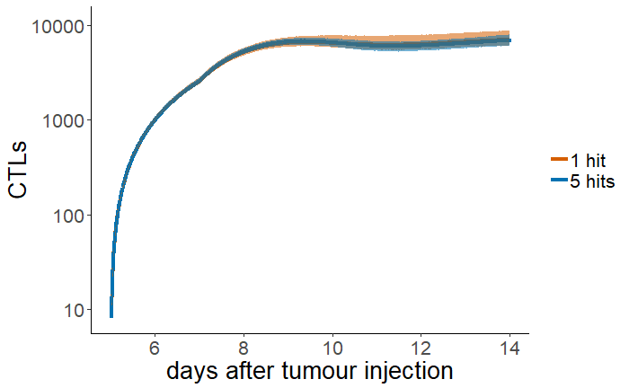
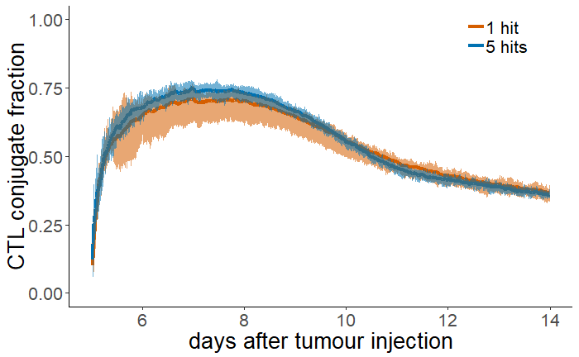
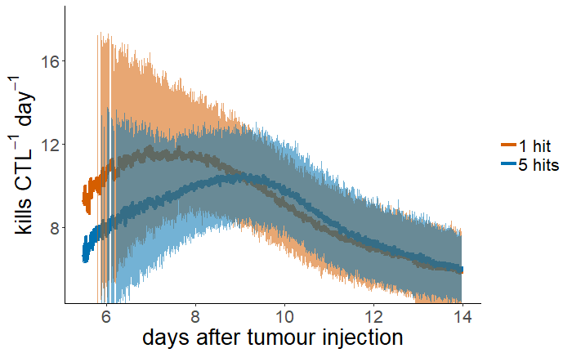
A
B
C
C
D

Slide 12
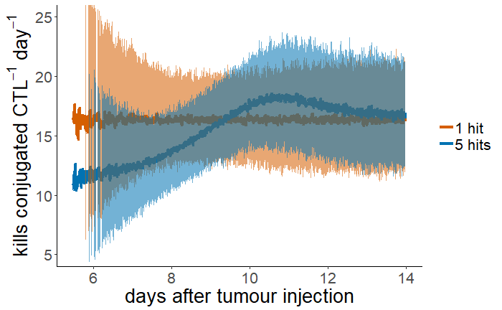
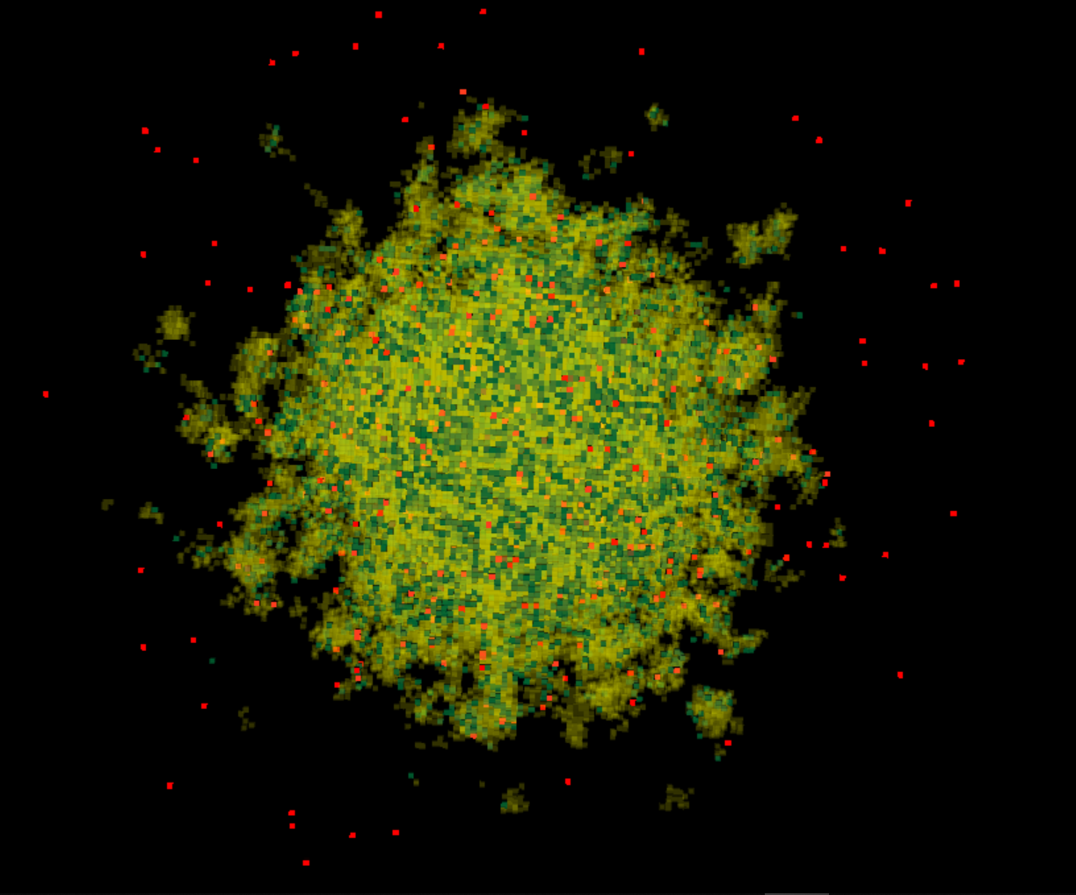
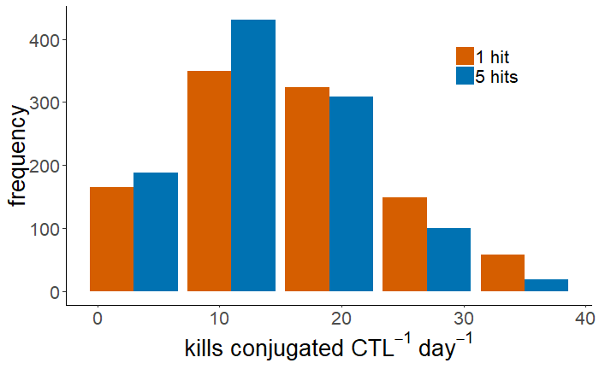
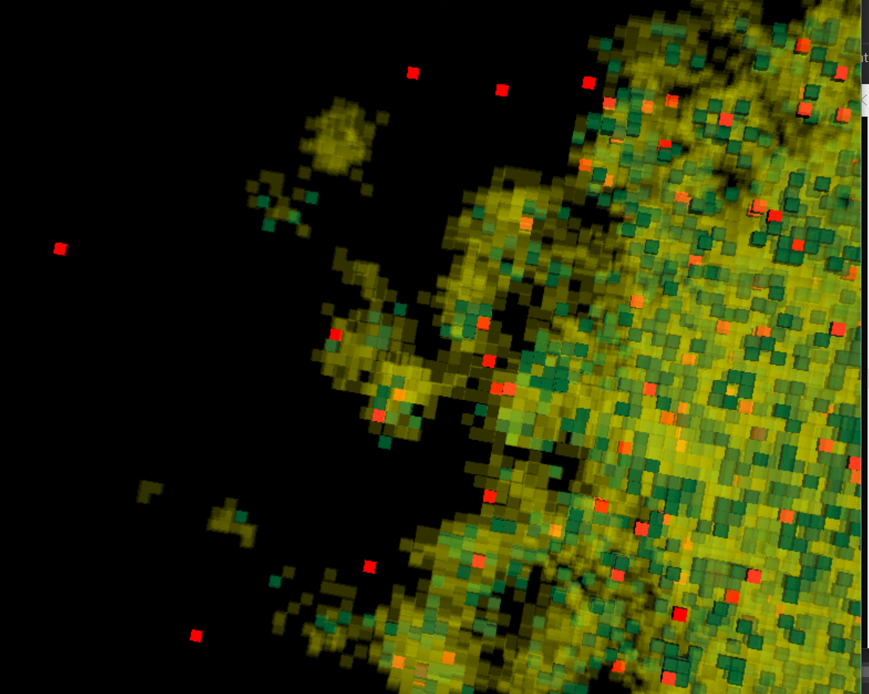
E
G
F

Slide 13
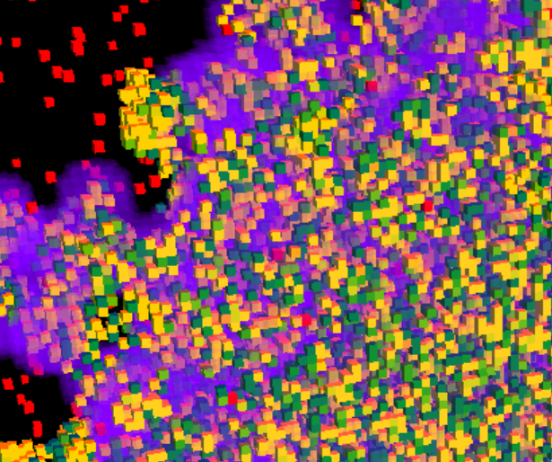
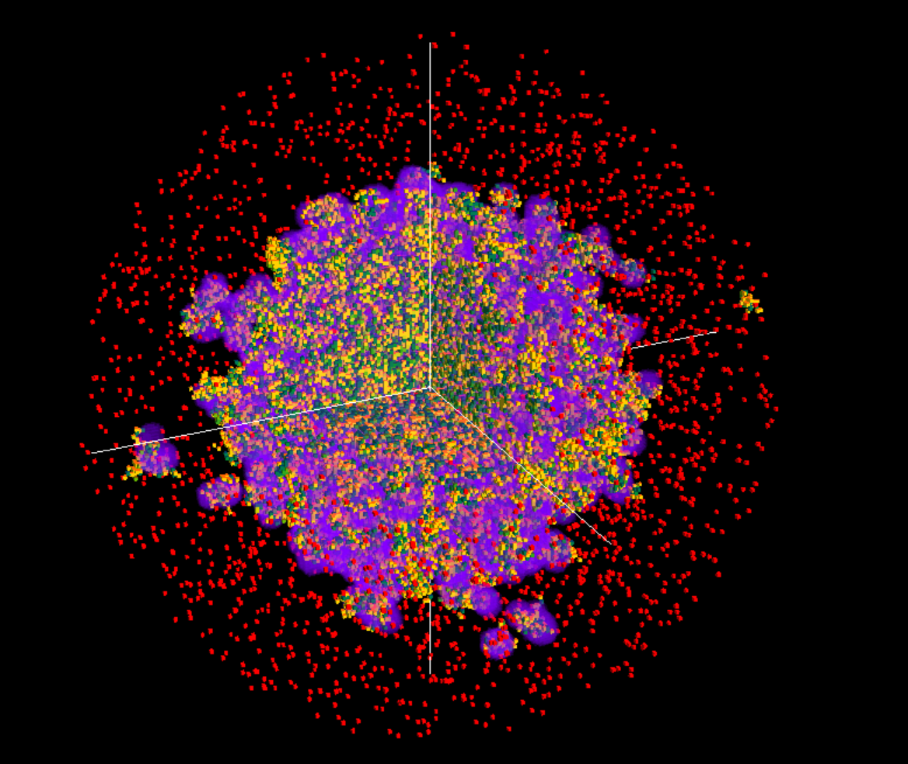
2mm
CTLs
IFNγ
healthy EG7
damaged EG7
dead EG7

Slide 14
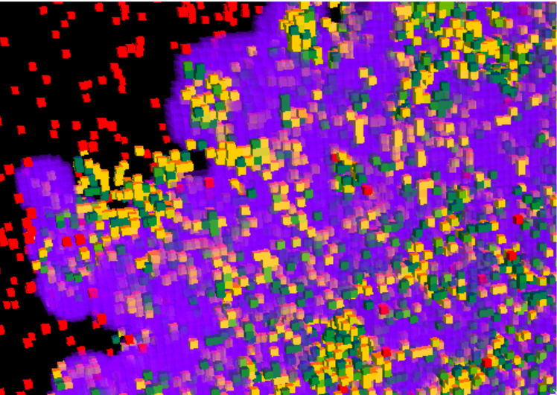

Slide 15
Figure 4. T cell cooperativity causes heterogeneous killing rate. Comparison of (A) Simulated tumour volume , (B) total number of CTL, (C) killing per simulated CTL, and (D) killing per conjugated CTL compared between simulations where CTL required 1 or 5 hits to kill targets, in the presence of IFNγ. E) killing rate measured from windows over 2 hours period beginning day 8. F) Distribution of damaged cells (green) amongst undamaged tumour cells (yellow) (CTL = red).

Slide 16
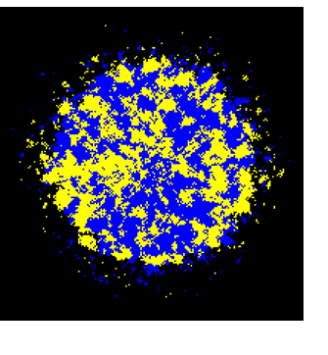
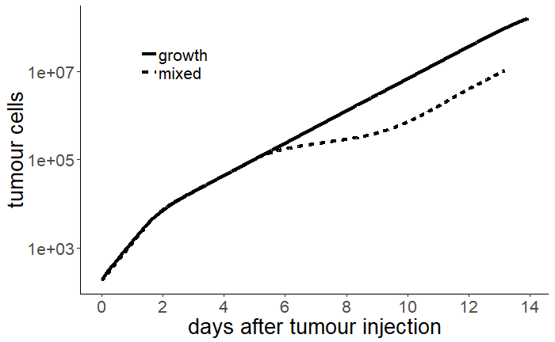
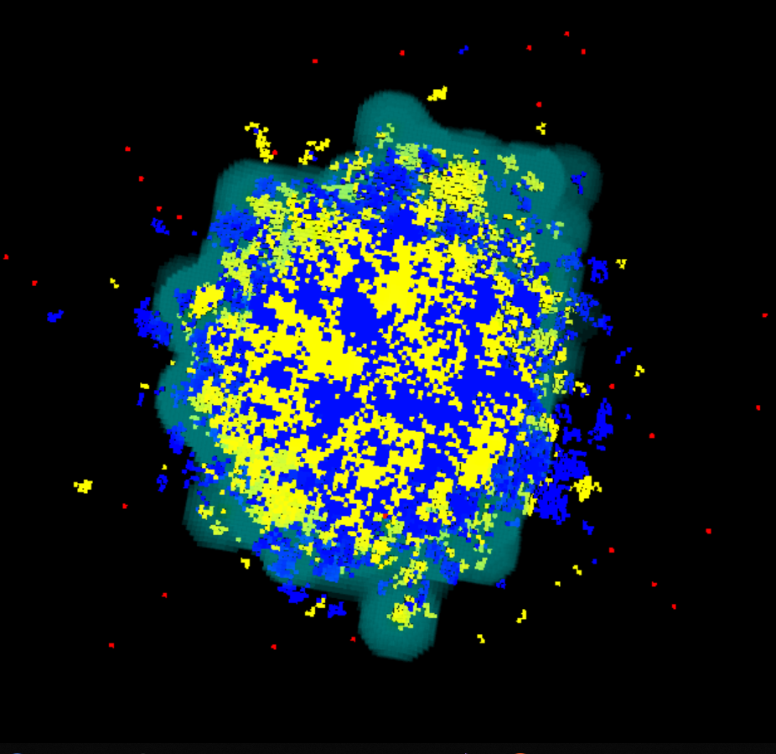
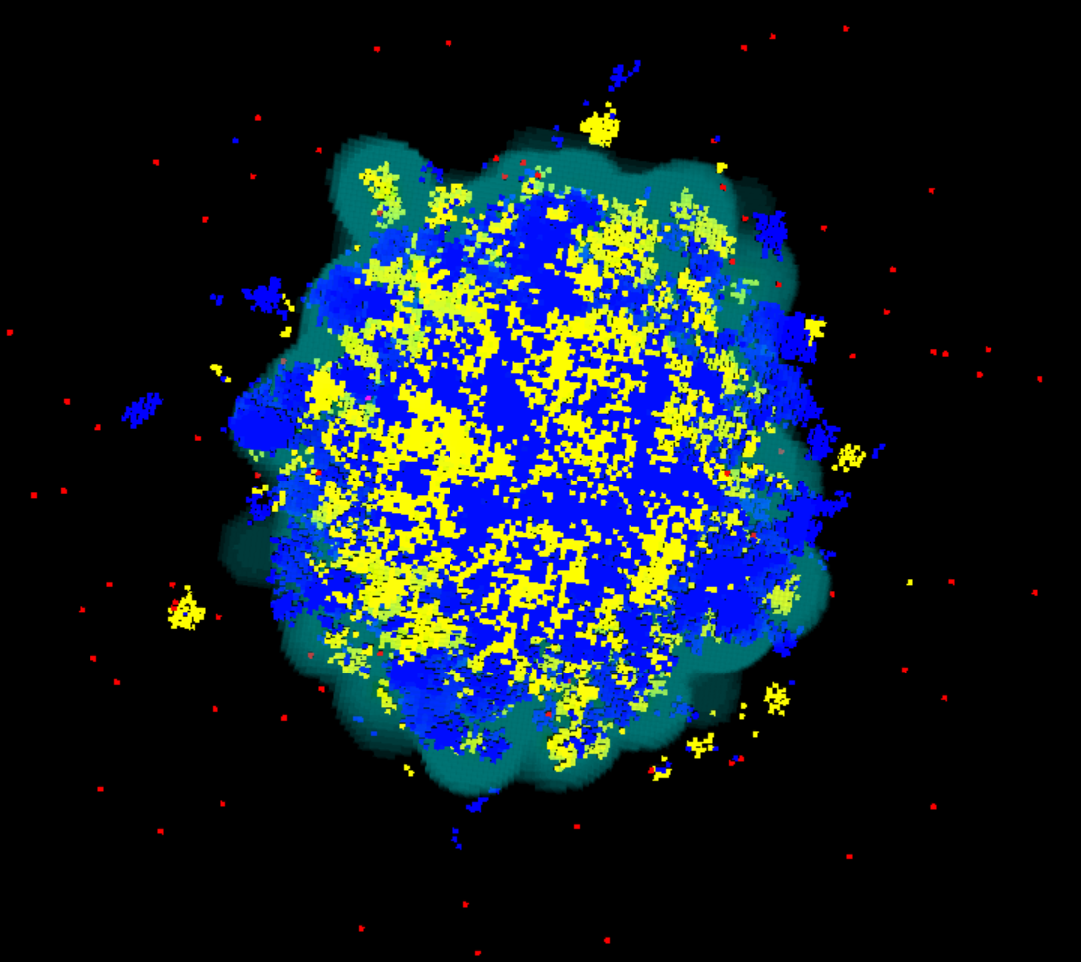
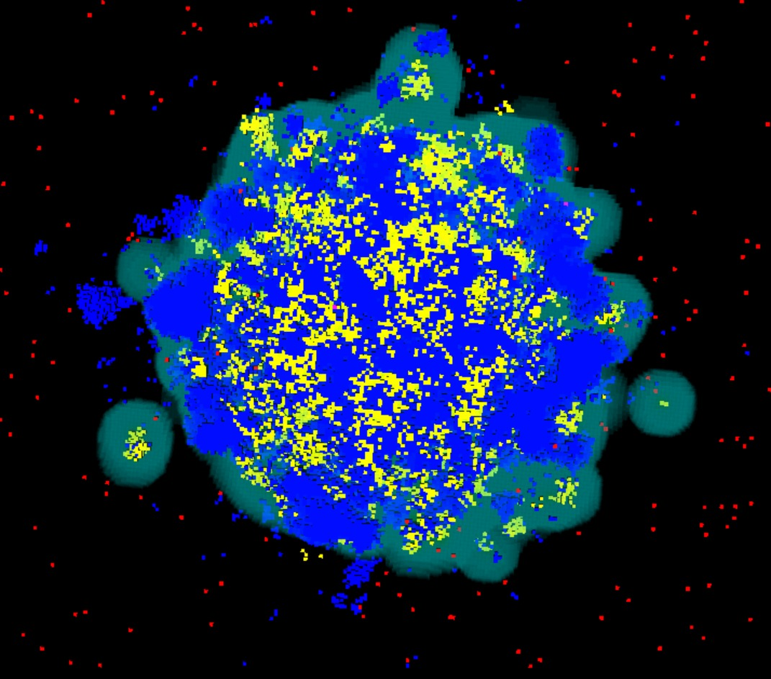
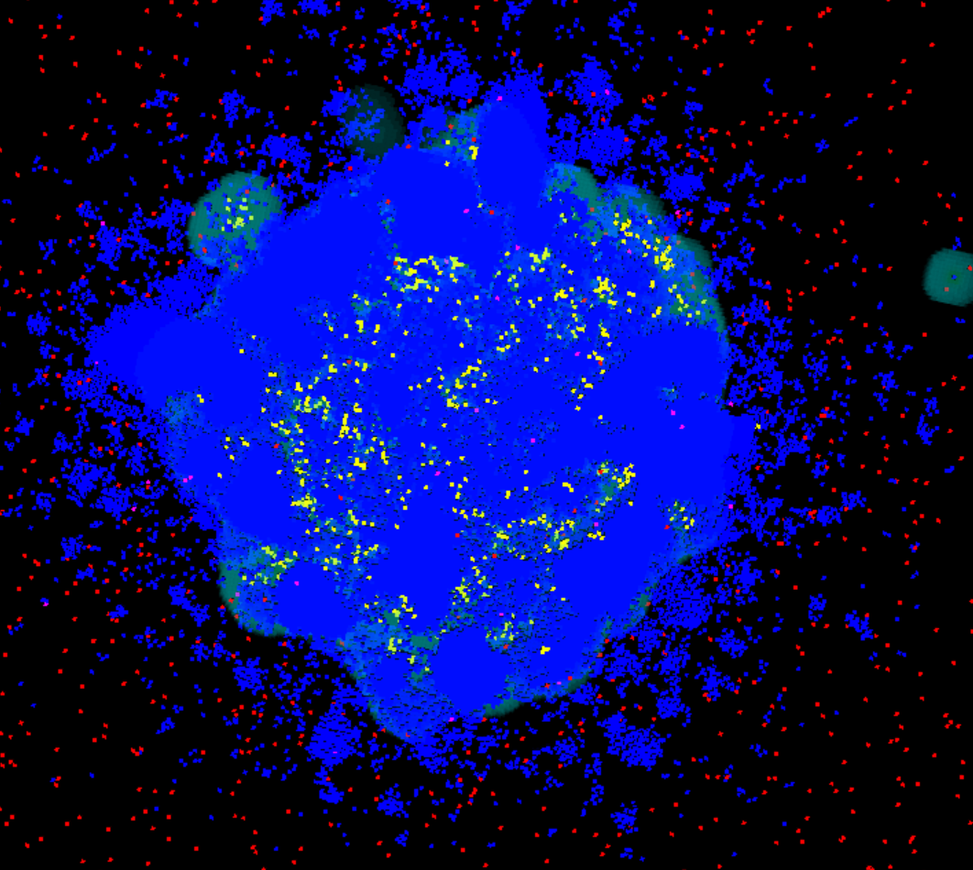
A
C
B
d6y
d7y
d8y
d10y

Slide 17
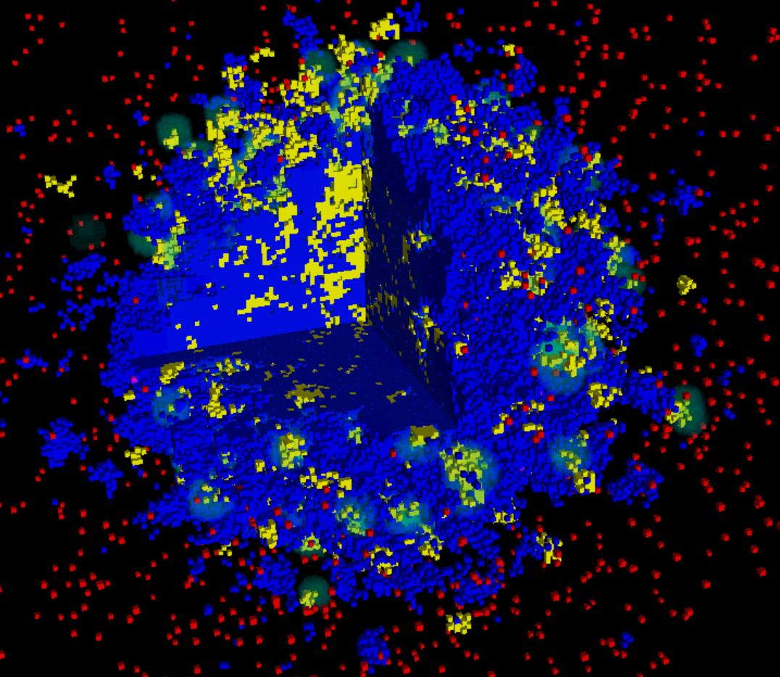

Slide 18
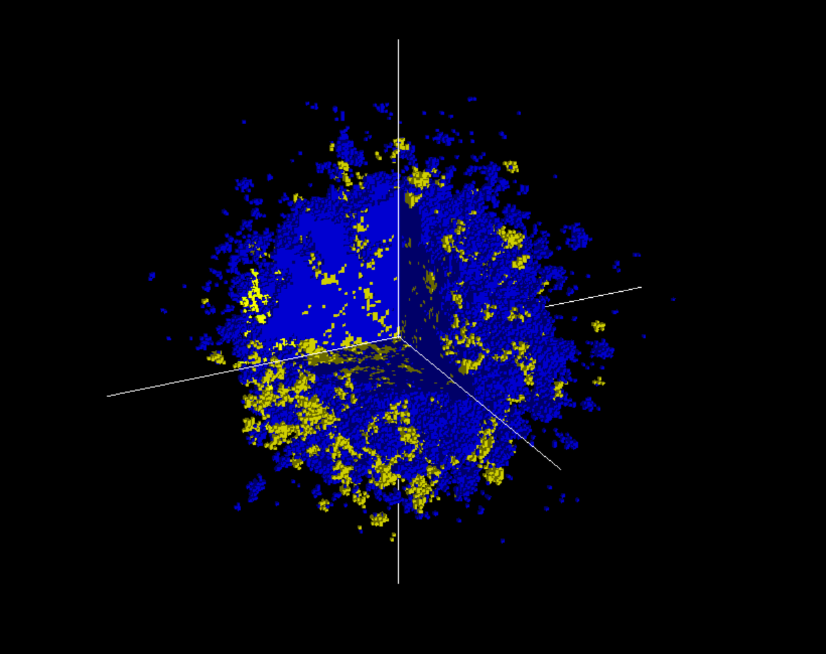
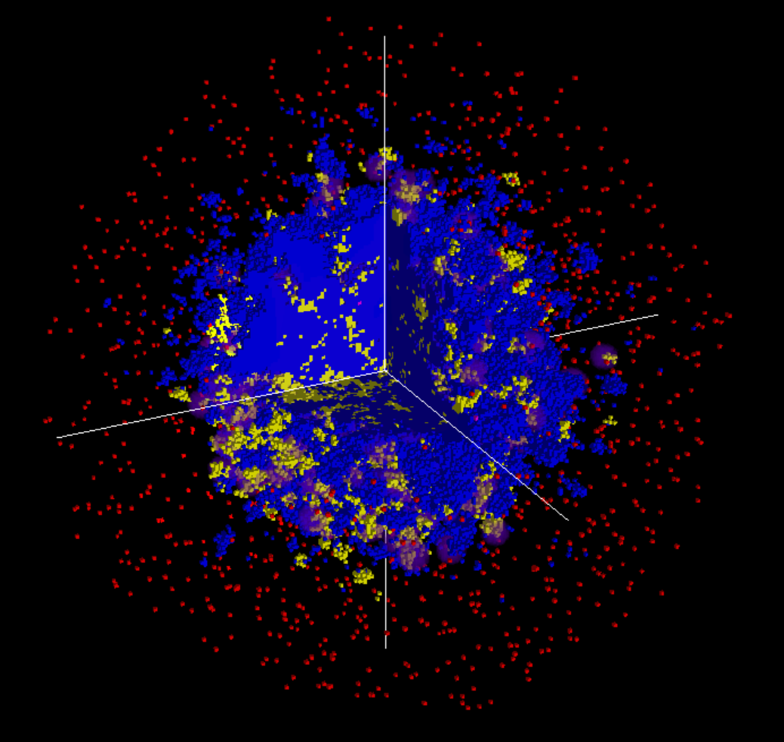

Slide 19
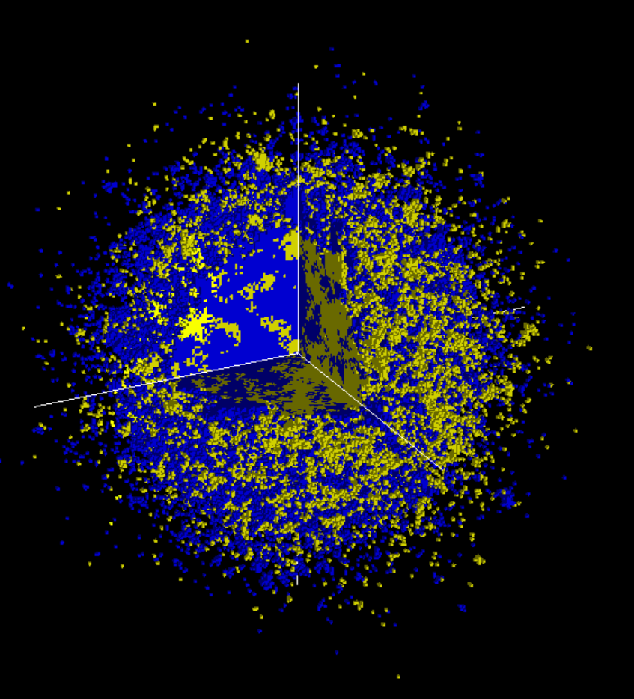
2mm

Slide 20
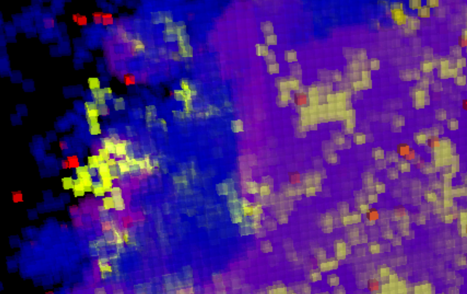
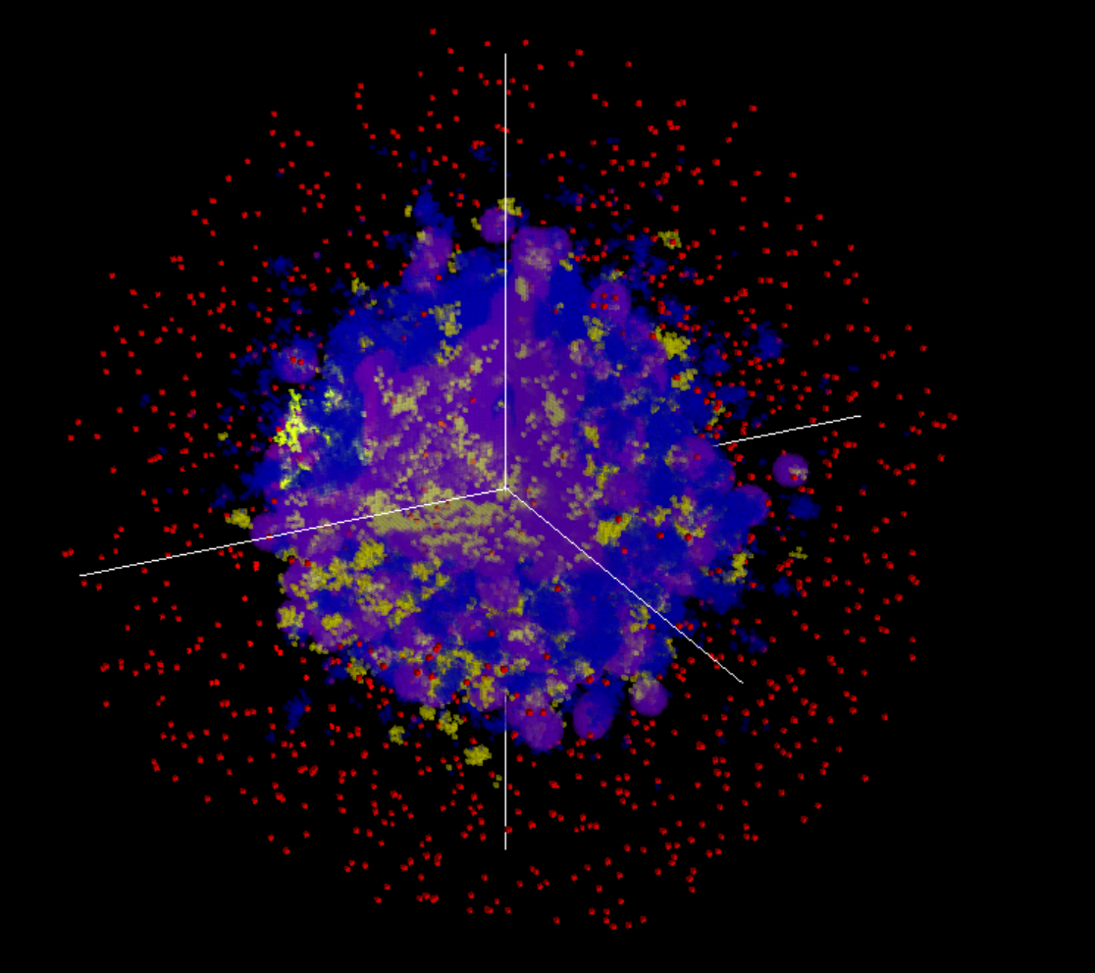
2mm
EL4 cells
CTLs
EG7 cells
IFNγ

Slide 21
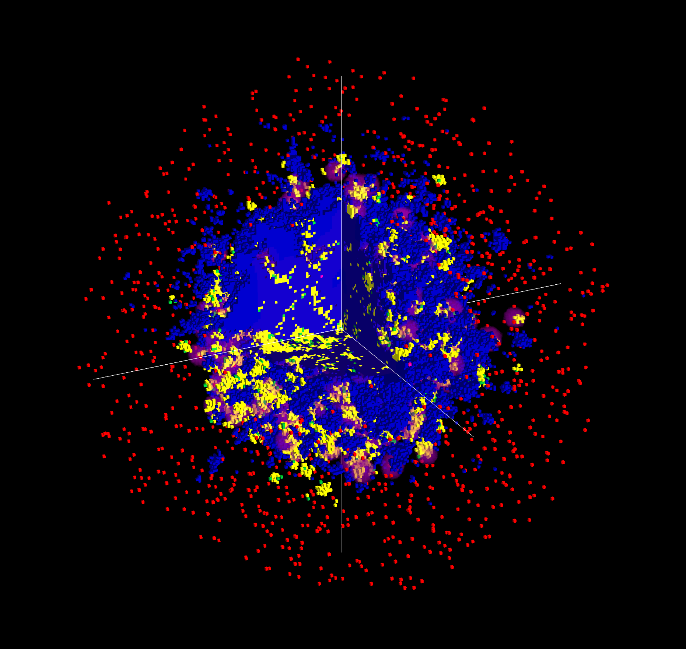

Slide 22
Figure 5. Antiproliferative IFNγ explains selective destruction of EG7 cells. A) simulated mixed tumour taken at 8 days after tumour inception, without CTL transfer B) Images showing examples of tumour composition. T cells (red), EG7 cells (yellow) and EL4 cells (blue) and IFNγ concentrations(violet) with killed cells in green C) Evolution of the total volume of EG7 and EL4 cells in mixed tumour simulations, with transfer of CTLs.

